Slide 1

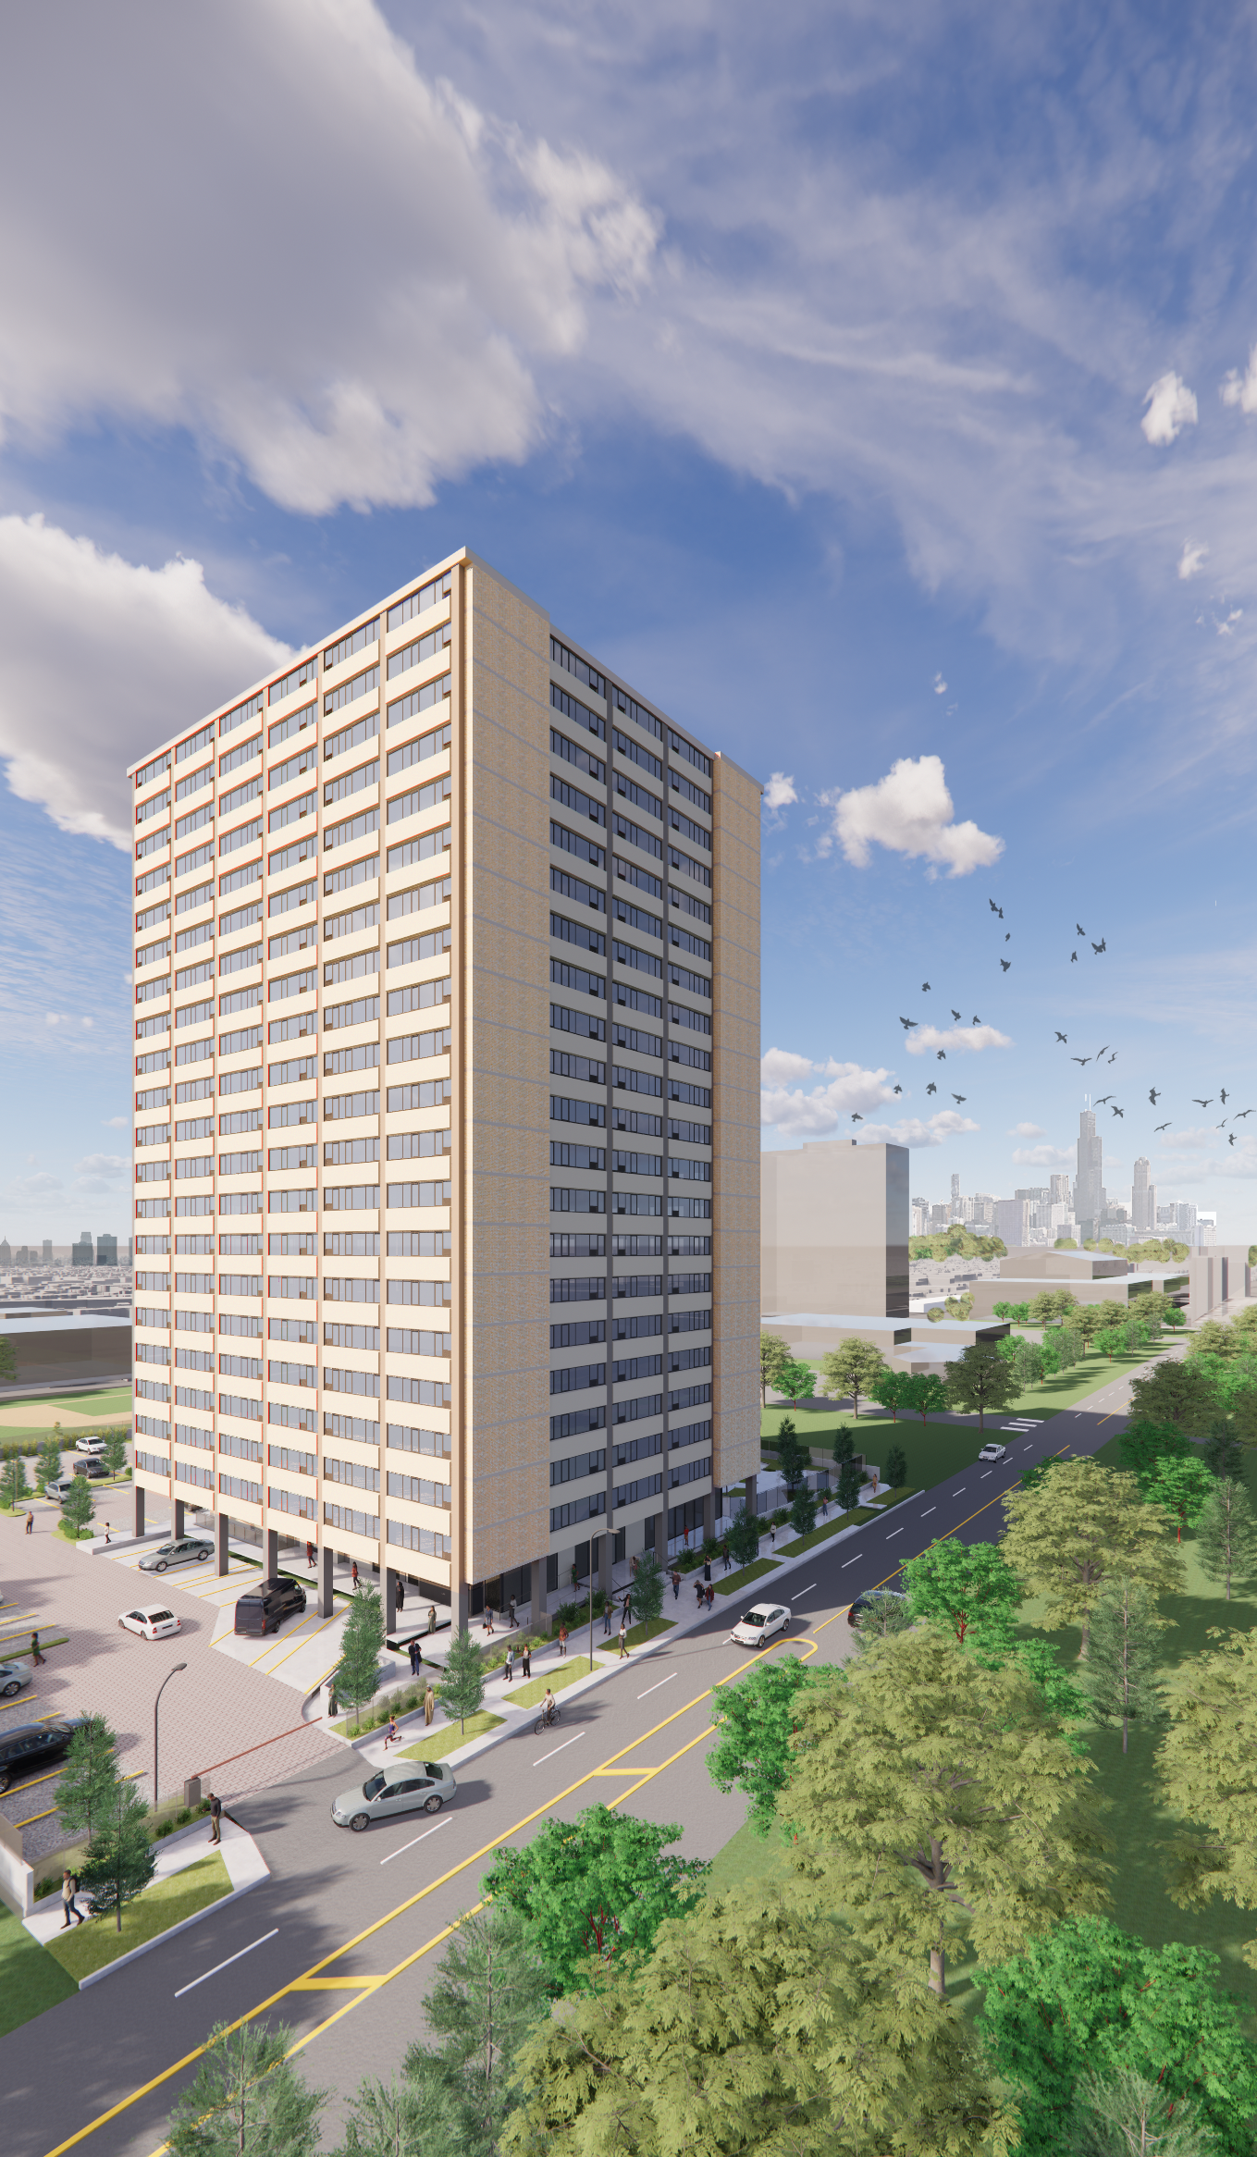
Island Terrace Renovation Renderings

Slide 2

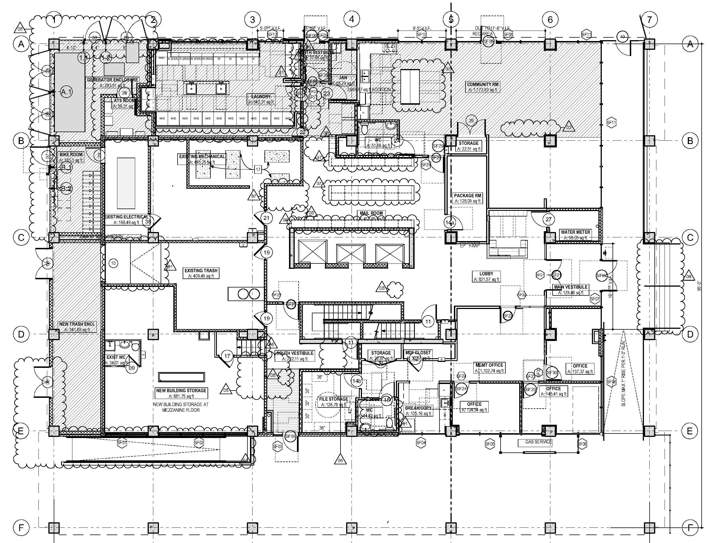
FIRST FLOOR BLUEPRINT

Slide 3
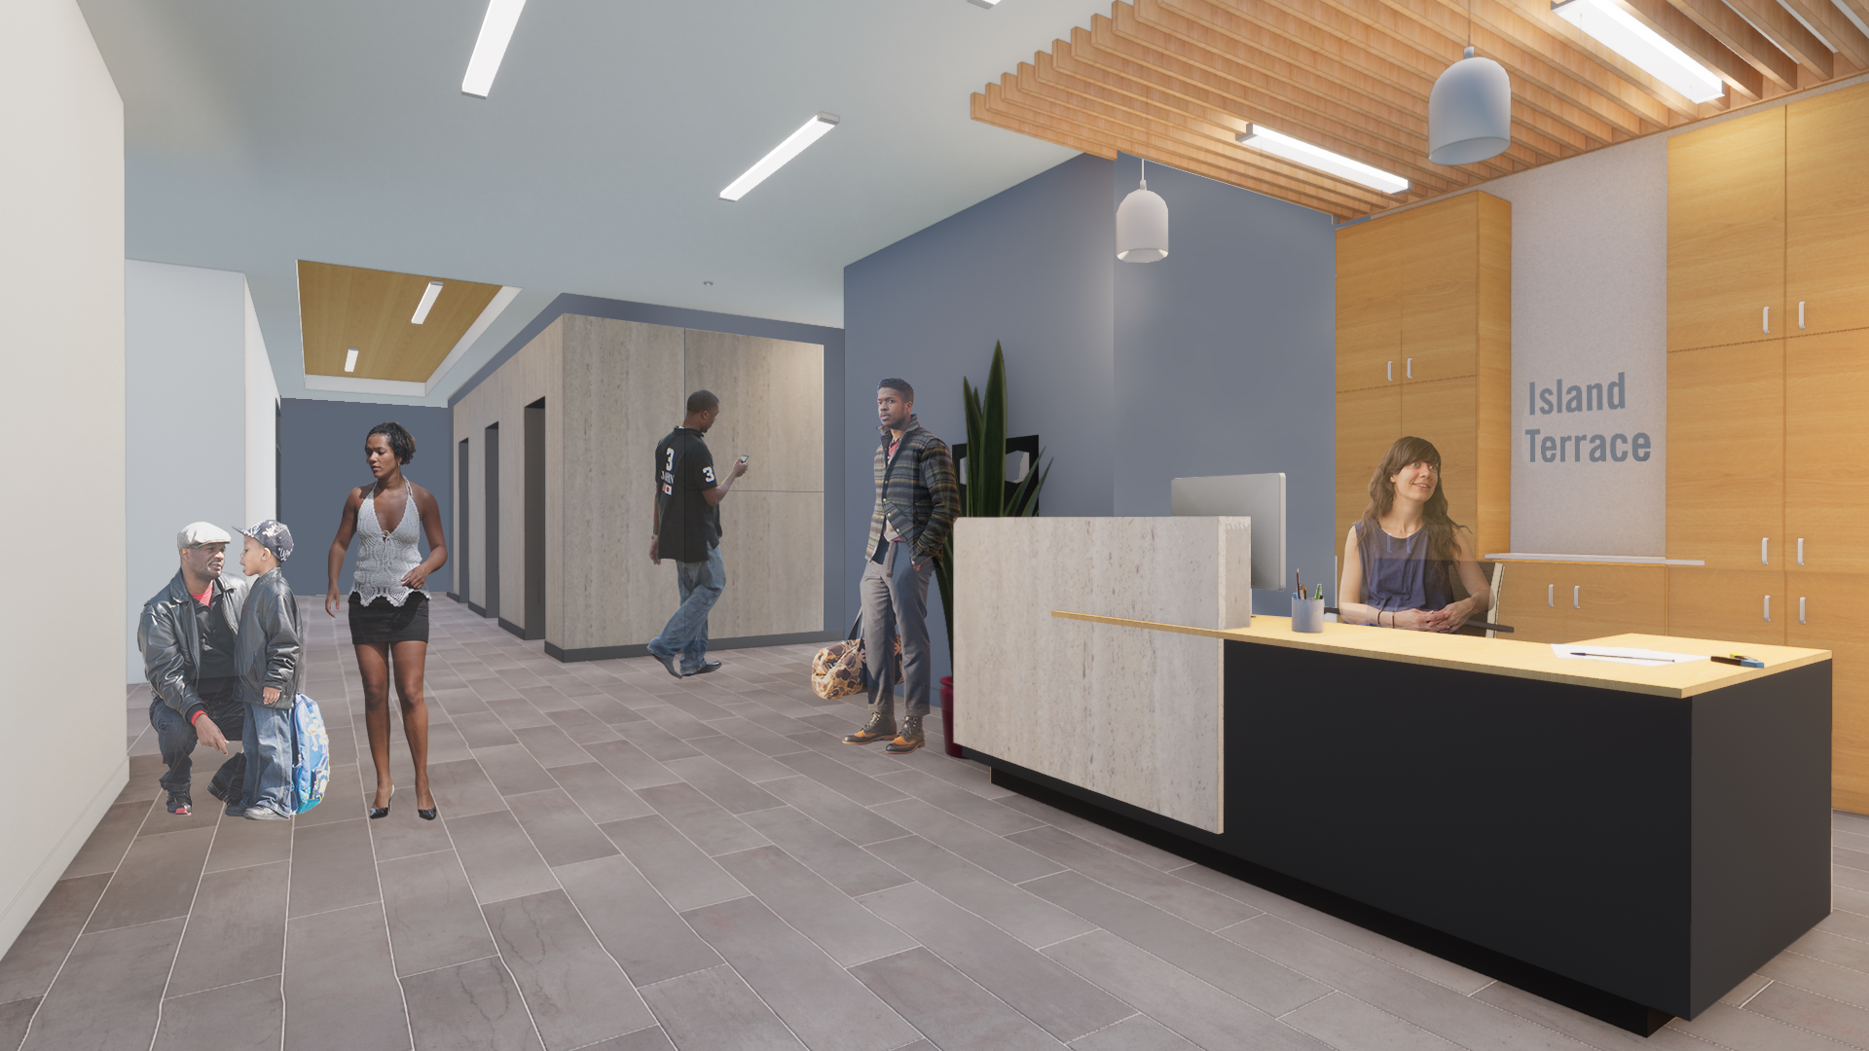
FRONT DESK/LOBBY
Welcome to Island Terrace! The new lobby greets you as you enter. The management office is directly across from the front desk, while the mail room and laundry room are located on the opposite side of the first floor.

Slide 4
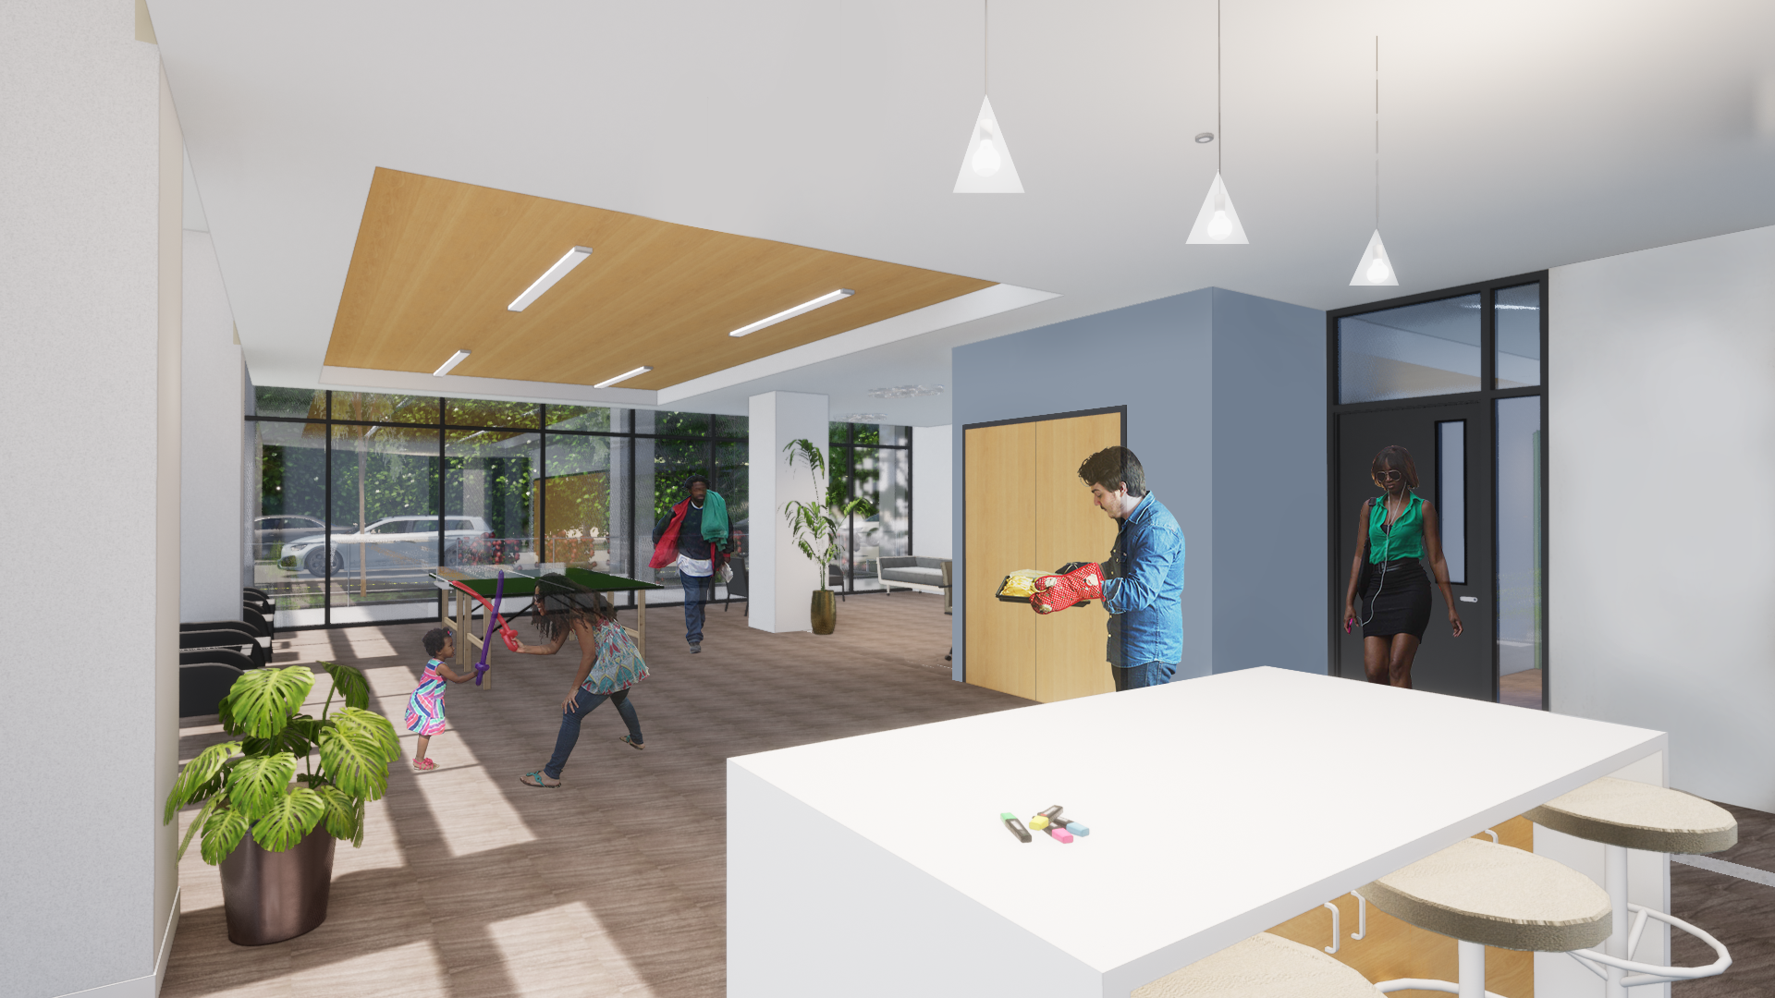
COMMUNITY ROOM
The first floor has a large community room with plenty of space for a variety of activities and programs for all residents.

Slide 5
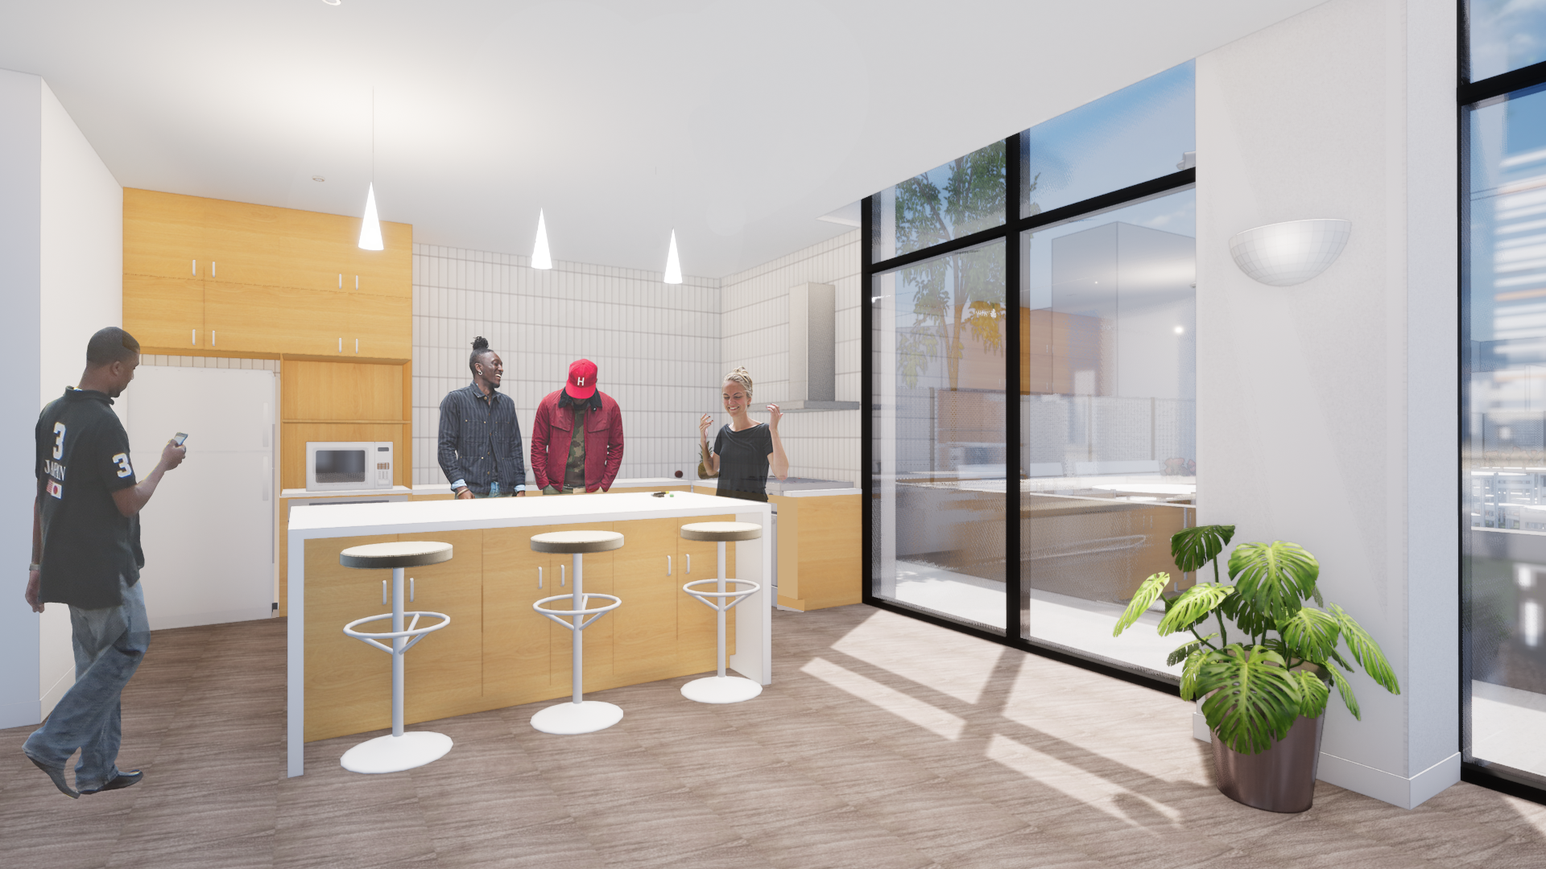
COMMUNITY ROOM (continued)
Attached to the community room is a communal kitchen available for use by all Island Terrace residents.

Slide 6
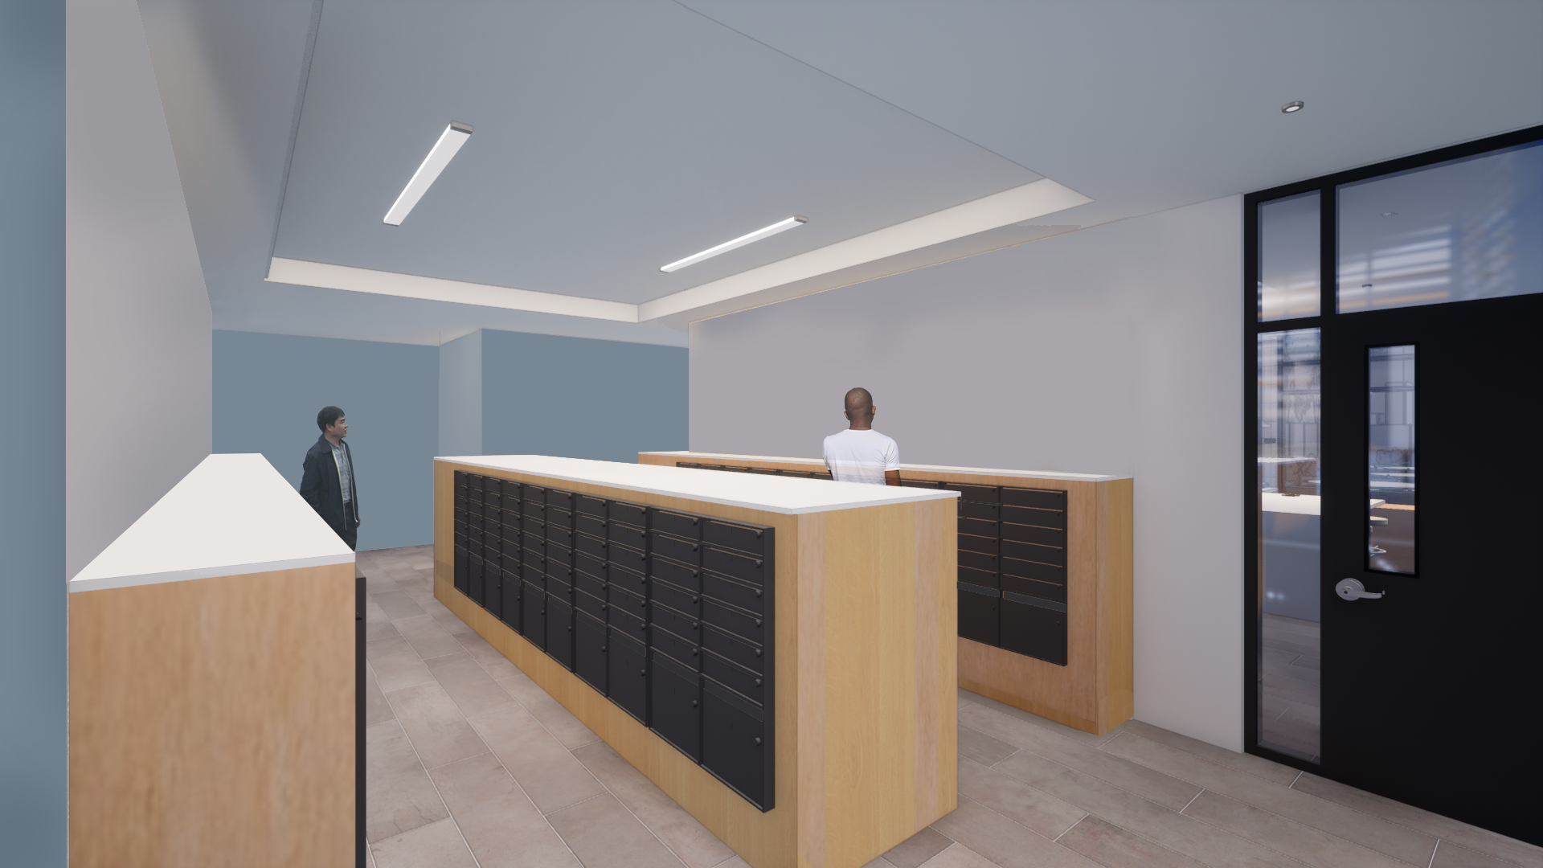
MAIL/PACKAGE ROOMS
The mail room and secure package room are conveniently located behind the lobby elevators.

Slide 7
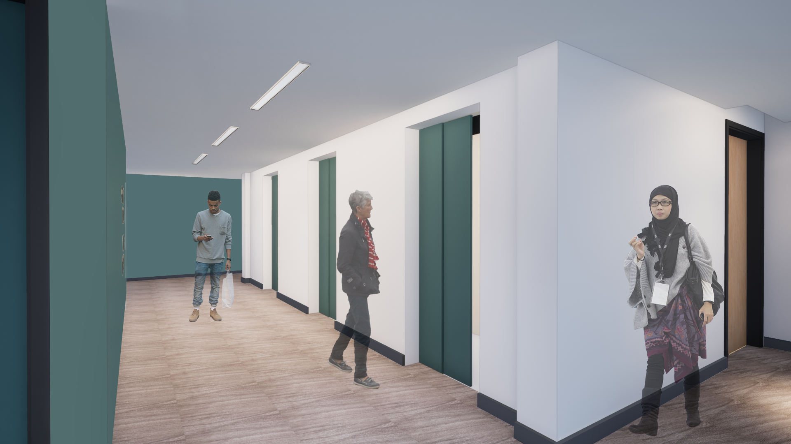
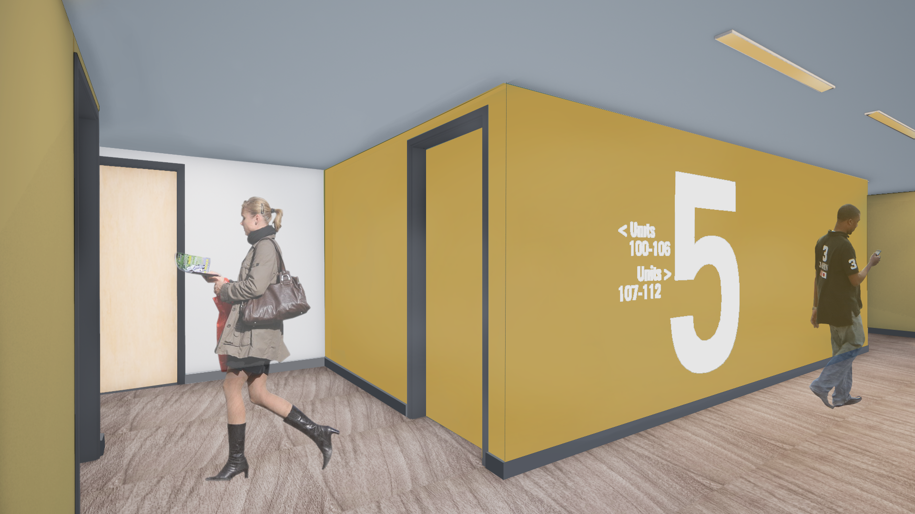
ELEVATOR ACCESS/FLOOR HALLWAYS
As you exit the modernized elevators, you are greeted with wood flooring that lines the entirety of the hallway.
The floor hallways have improved overhead lighting and alternate in color to differentiate between floors.

Slide 8
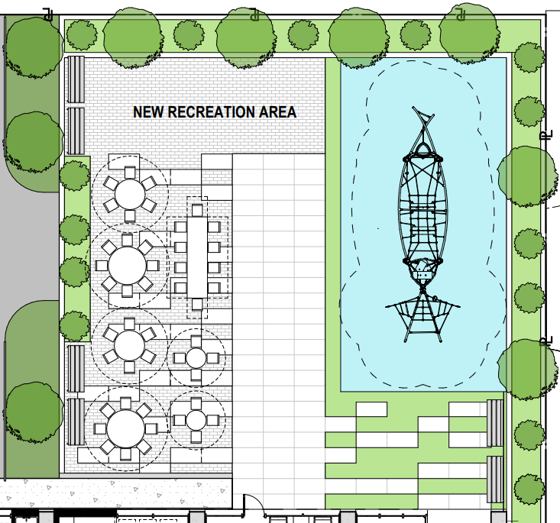
OTHER IMPROVEMENTS AT ISLAND TERRRACE
1. New outdoor space and recreation area with picnic tables and a children’s play area (as shown below)
2. New bicycle storage rooms
3. New parking lot with increased security
4. A north-facing, handicap accessible entrance to the parking lot and outdoor space
We can’t wait for you to see the new Island Terrace!

