Slide 1

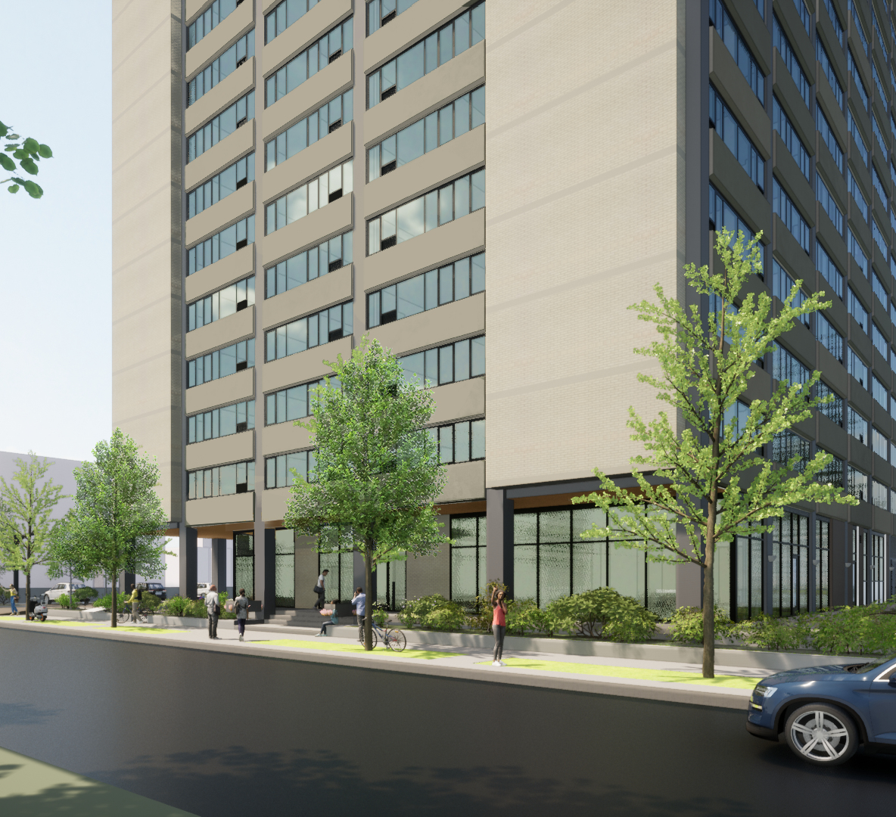
Island Terrace Renovated Unit Virtual Tour

Slide 2

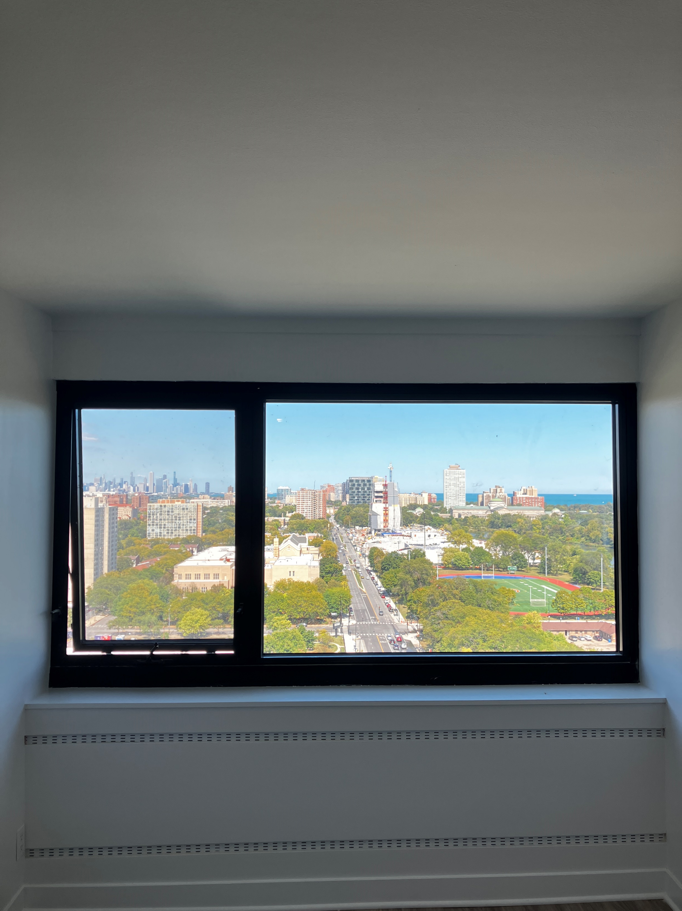
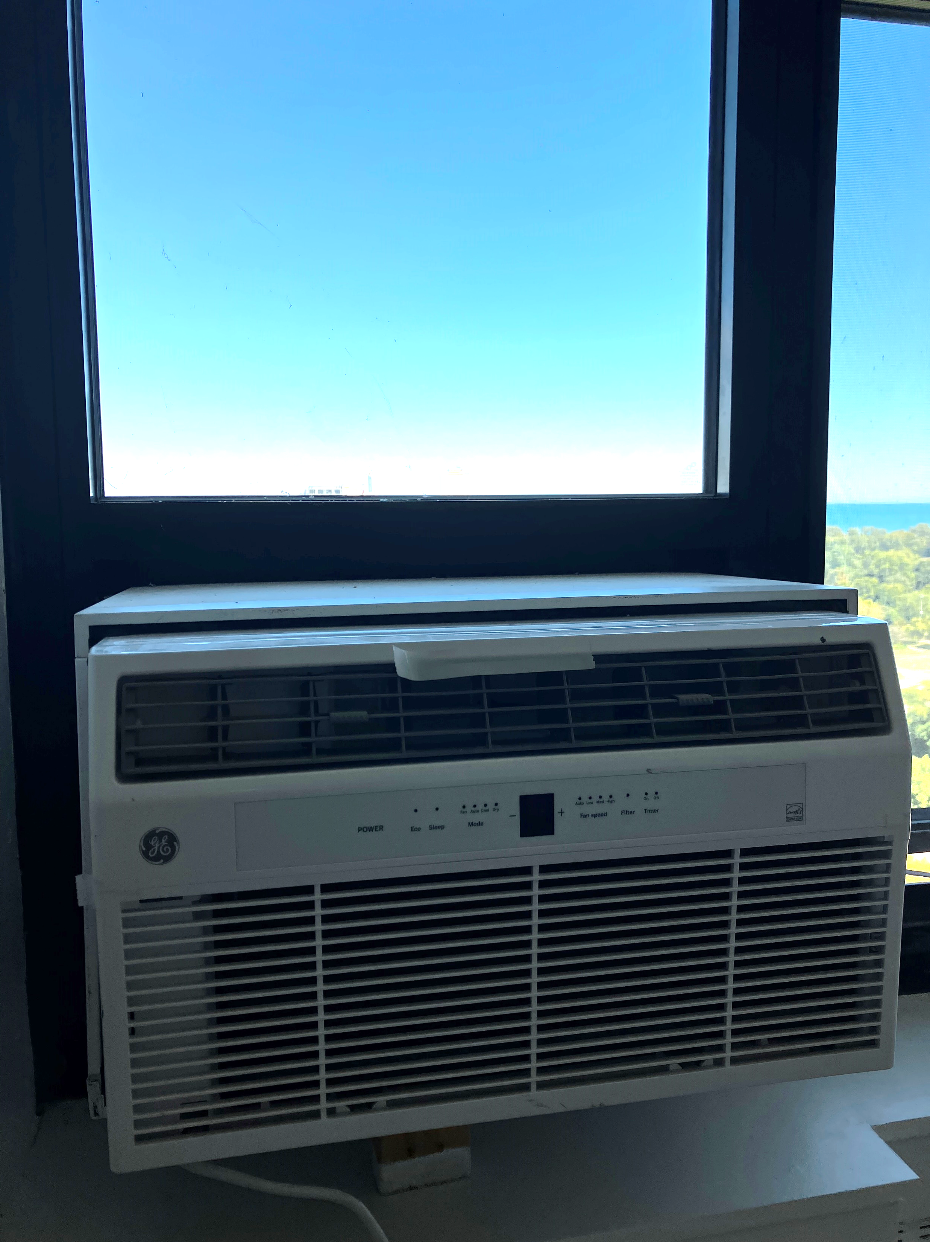
WINDOWS & AC
Provided in-window air conditioning unit*
New Windows that allow more light into the units
*Note that your current air conditioner will not be able to be mounted with the new windows. Please make plans to store or get rid of your current units. 1-bedroom apartments will have 1 AC unit and 2 & 3 bedroom apartments will have an additional AC unit in the primary bedroom.

Slide 3
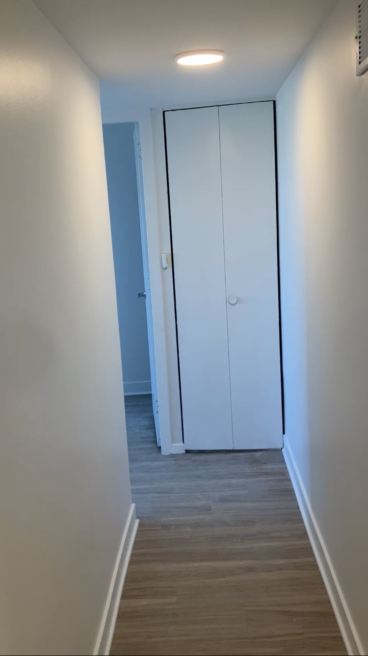
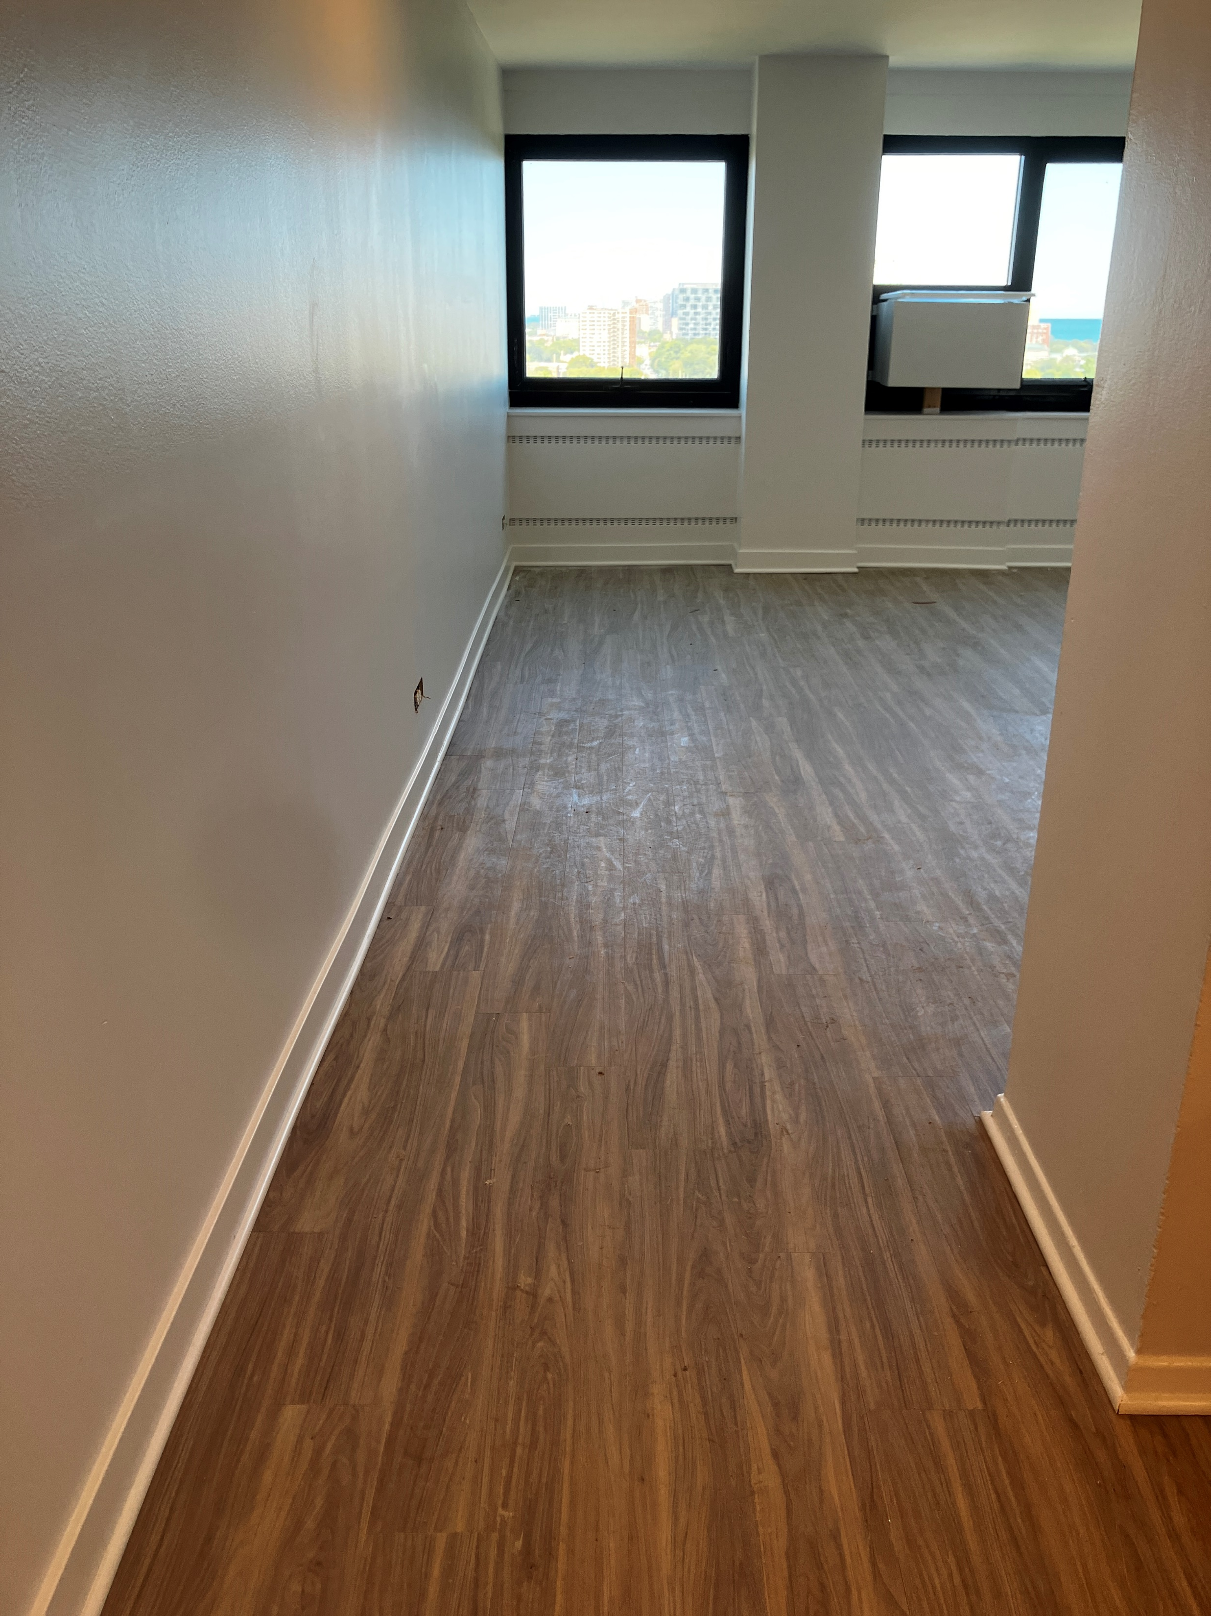
FLOORING
Wooden flooring covers the entirety of the apartment including in the bathroom

Slide 4
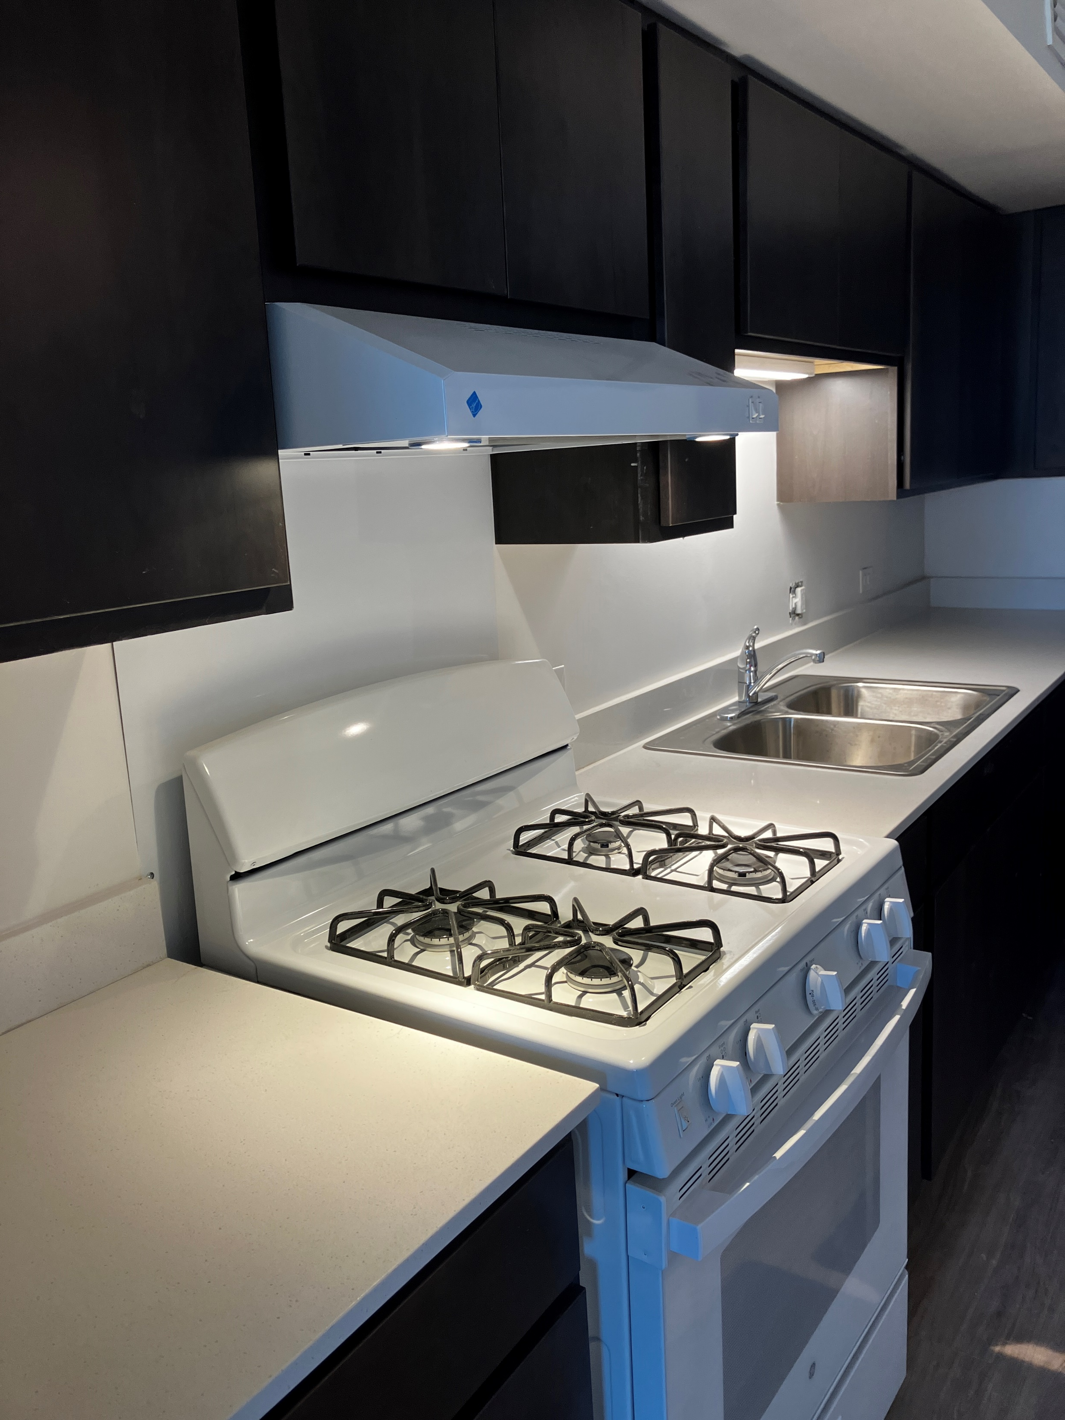
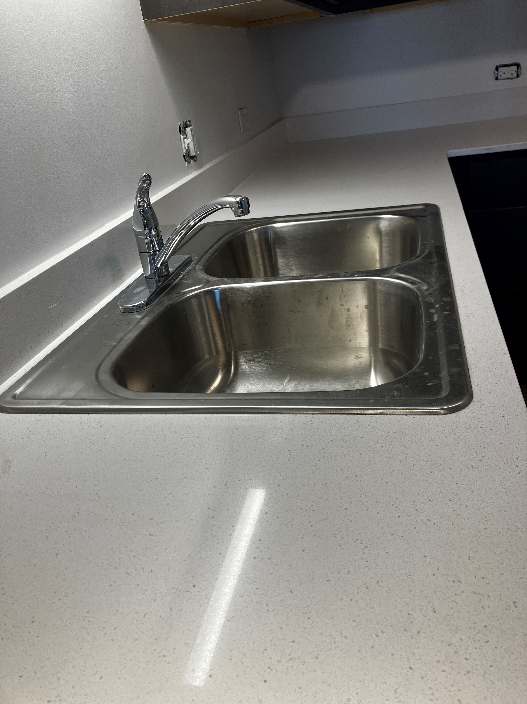
KITCHEN
New remodeled kitchen, with additional cabinets and countertop space.
Double basin kitchen sink

Slide 5
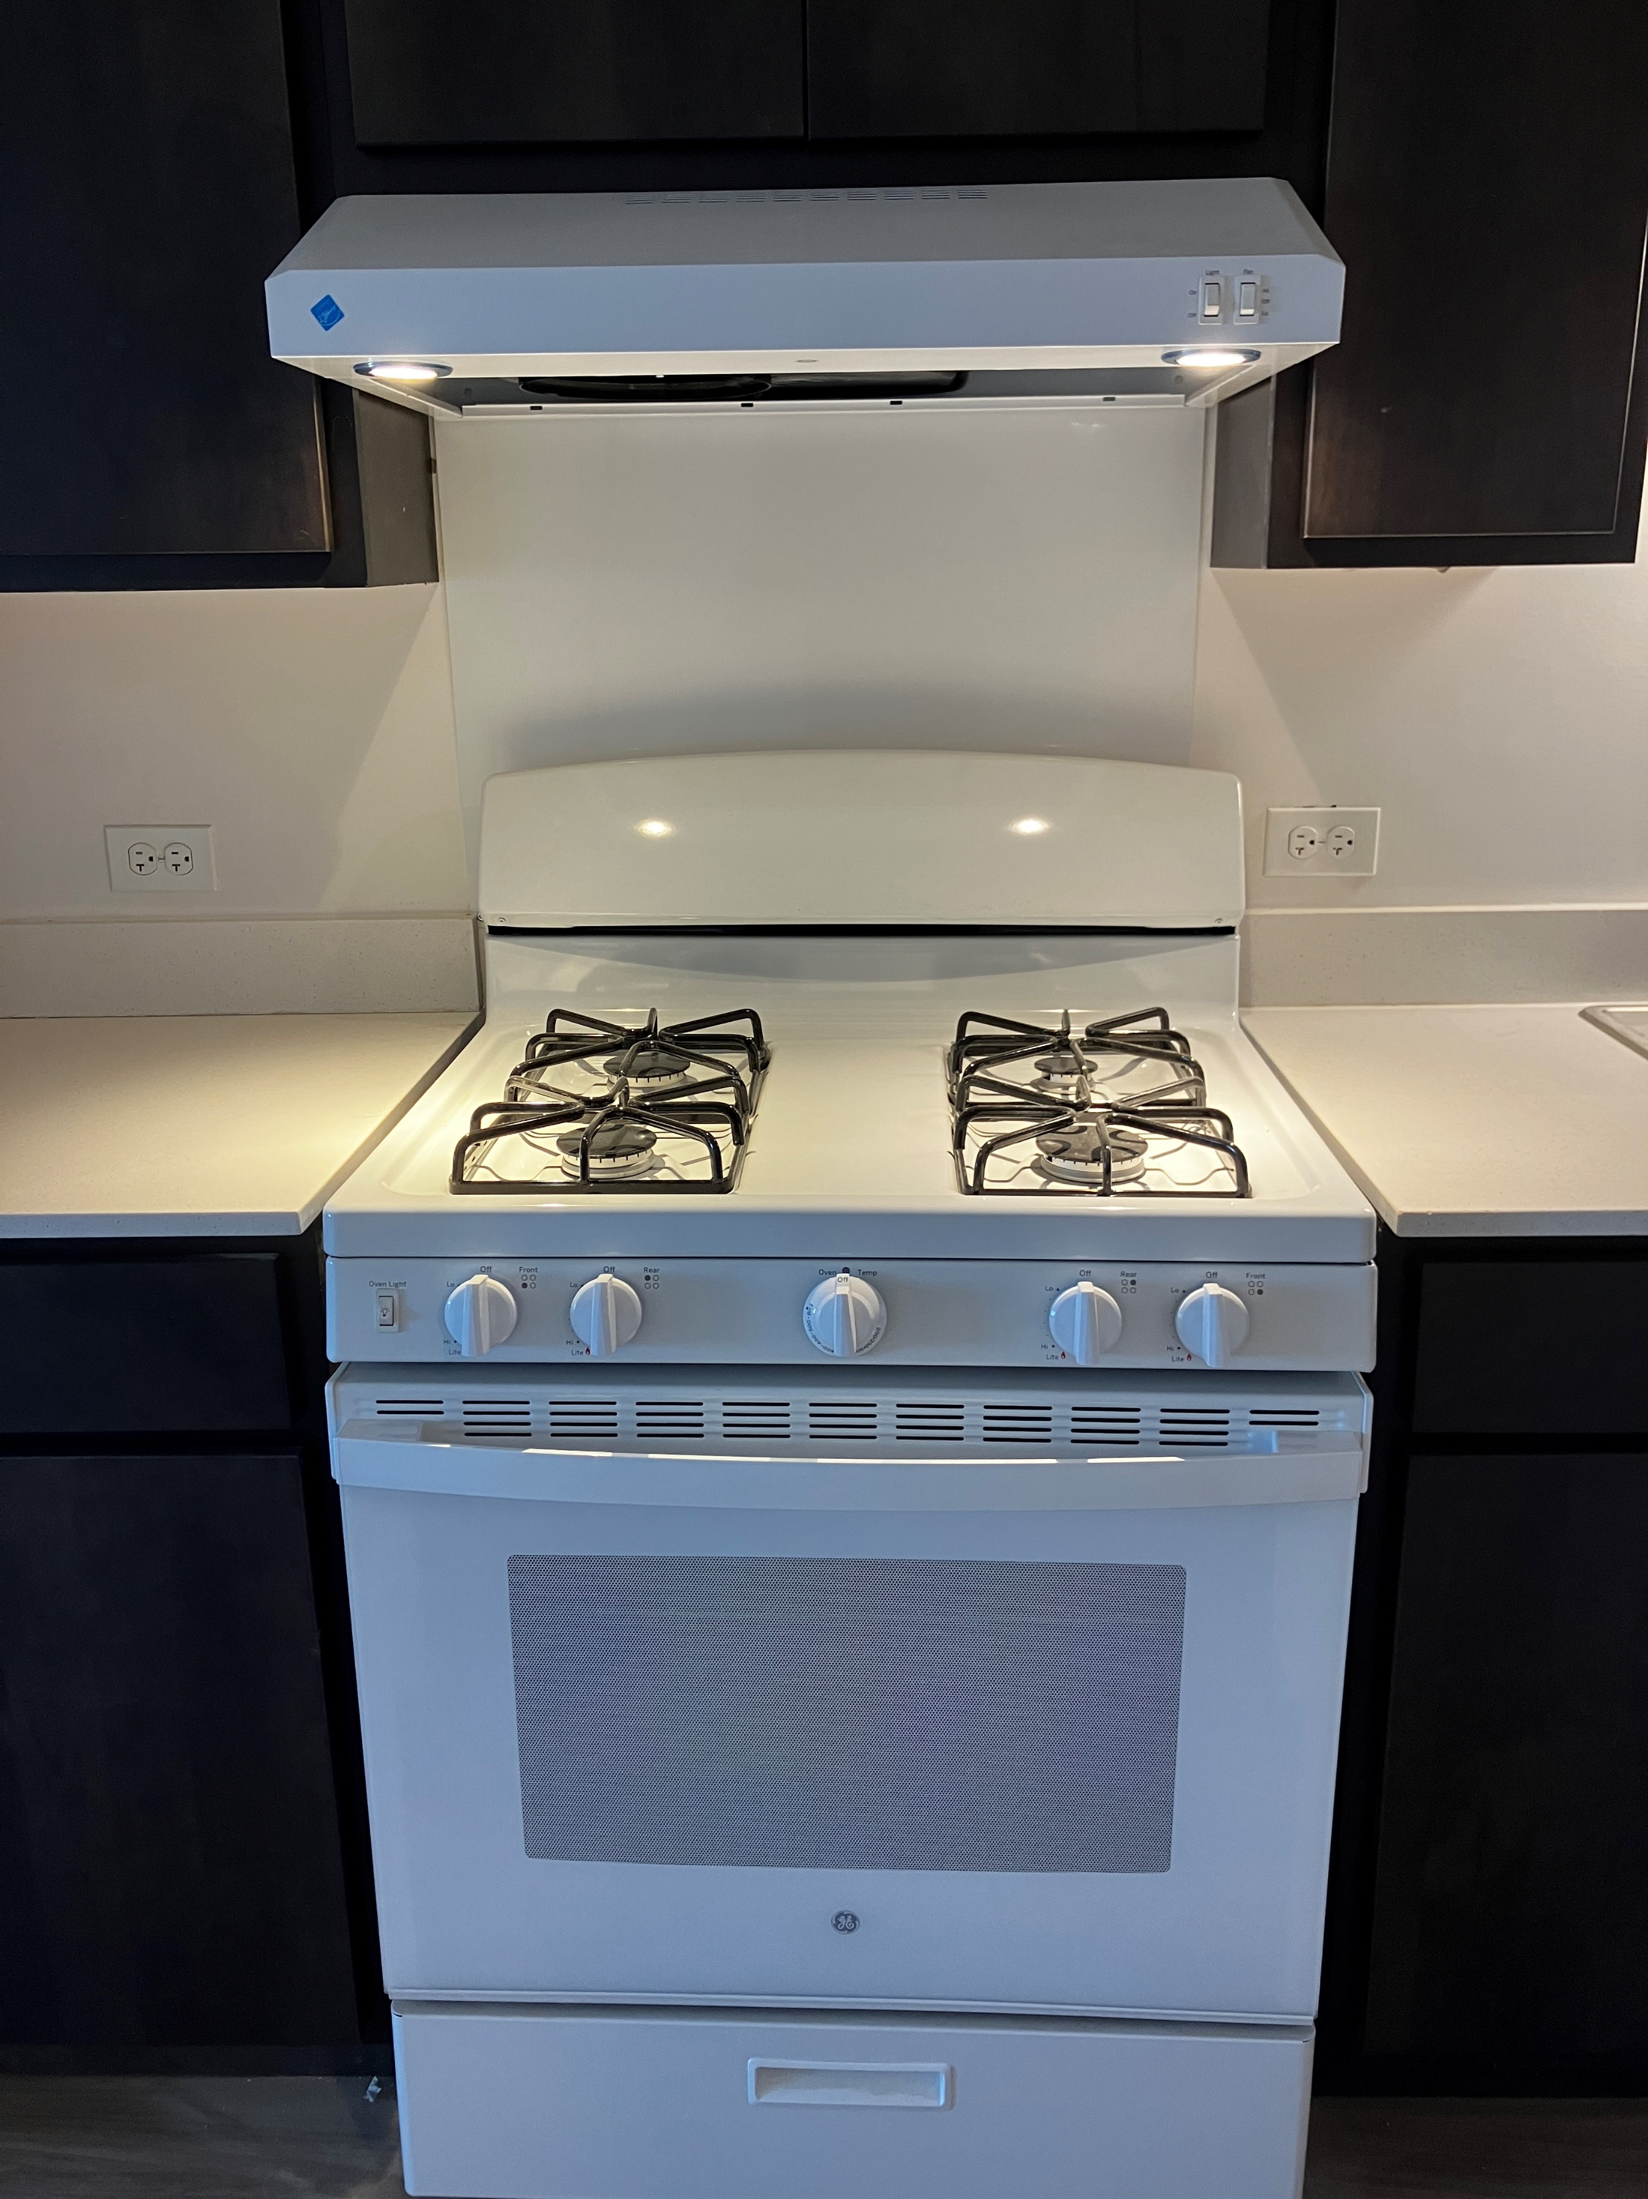
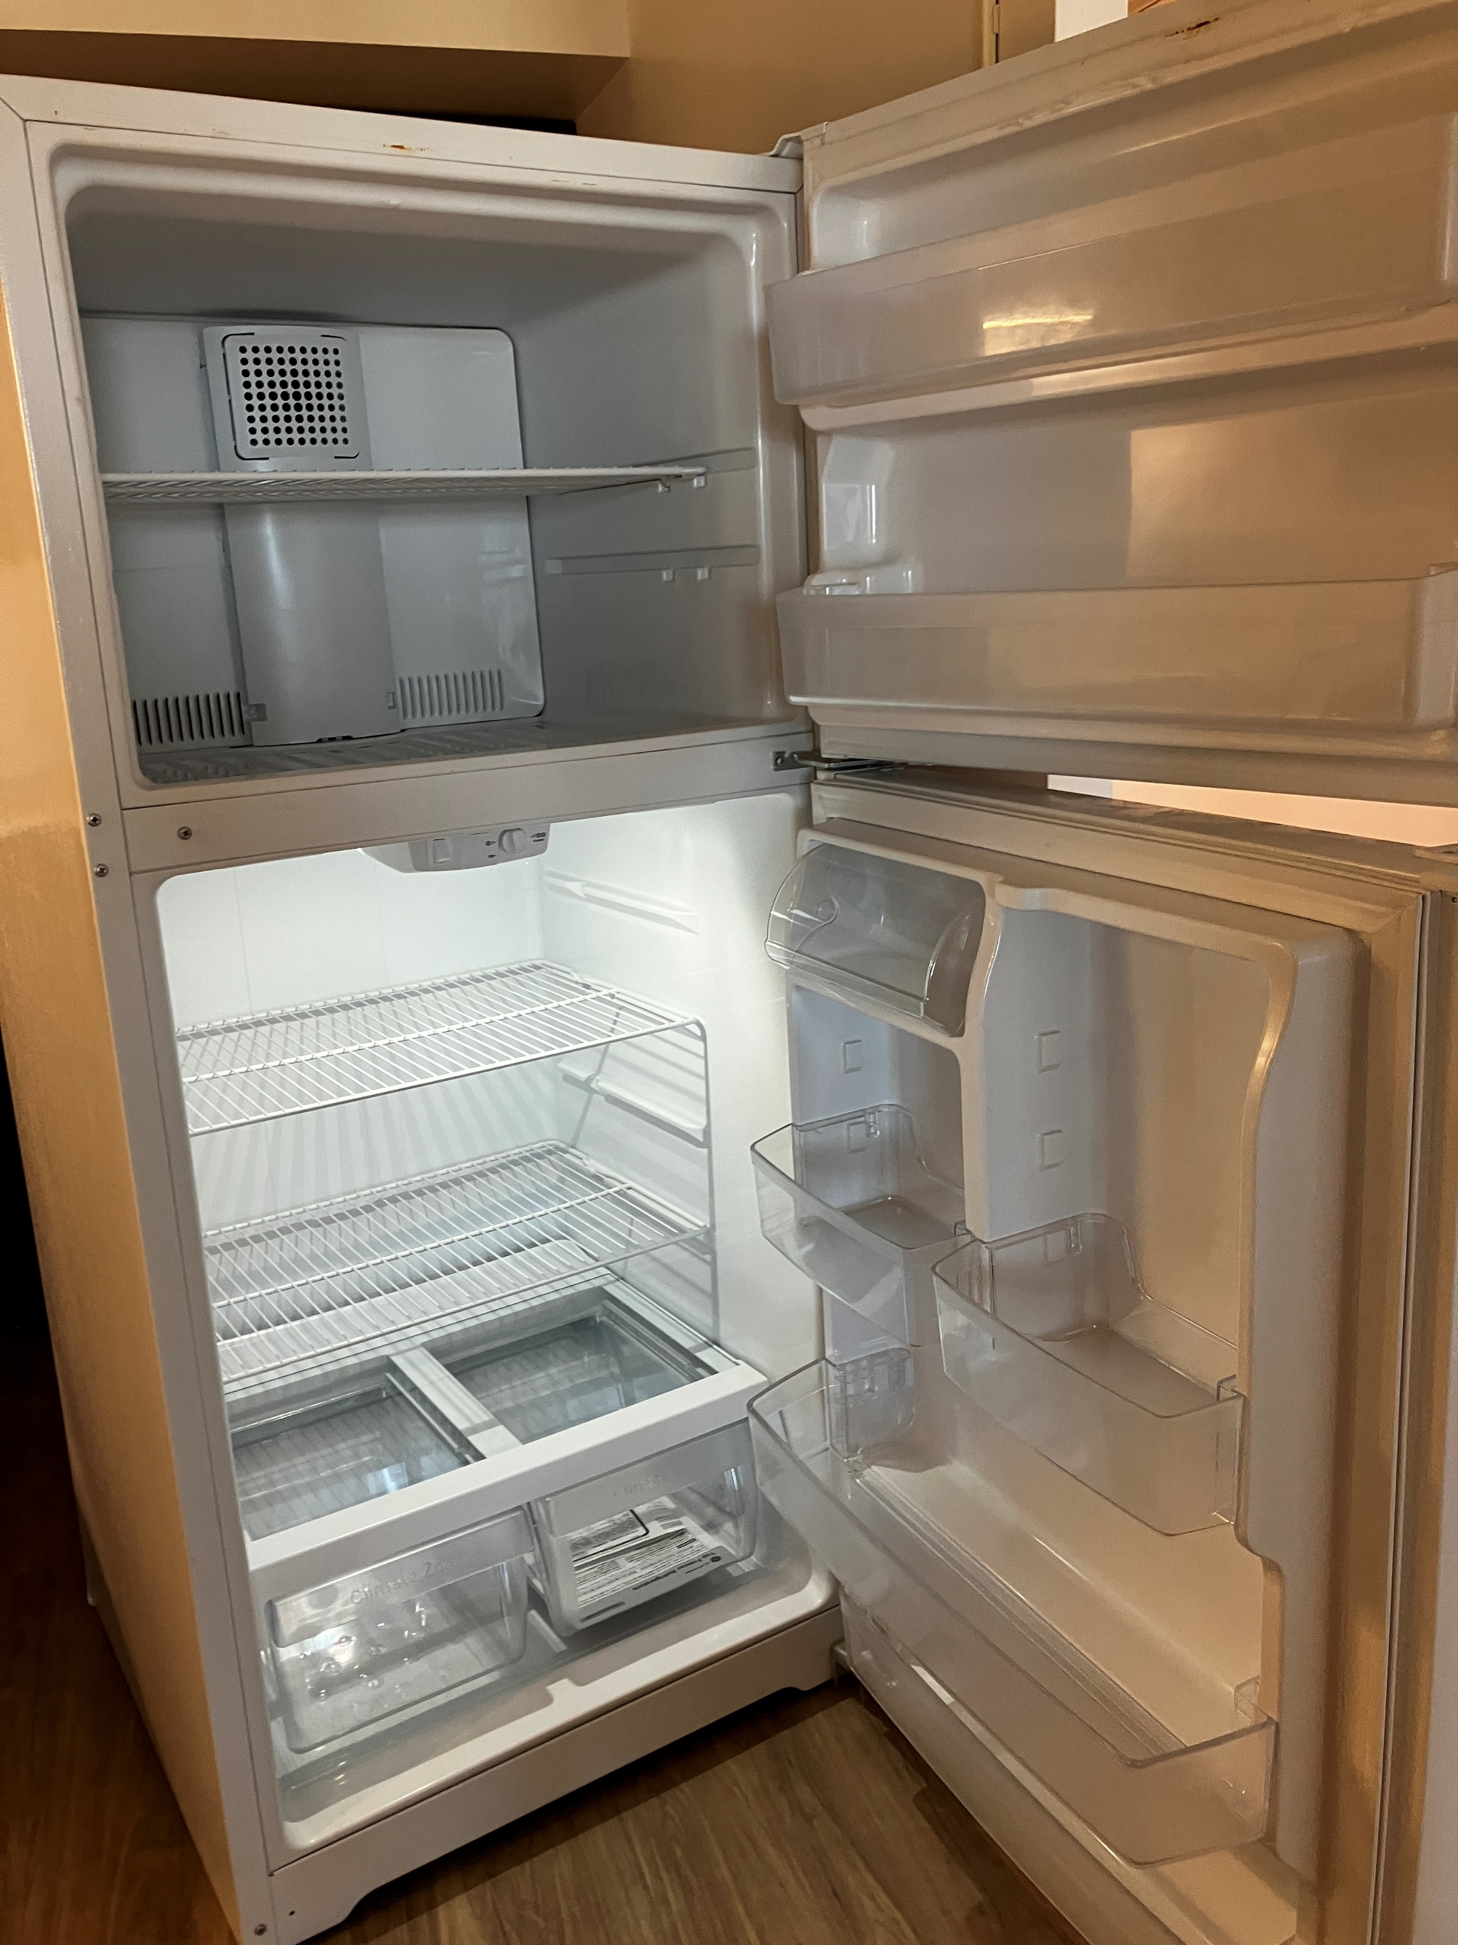
KITCHEN (continued)
Brand new GE appliances including a GE stove, oven, and range hood
New, larger GE refrigerator

Slide 6
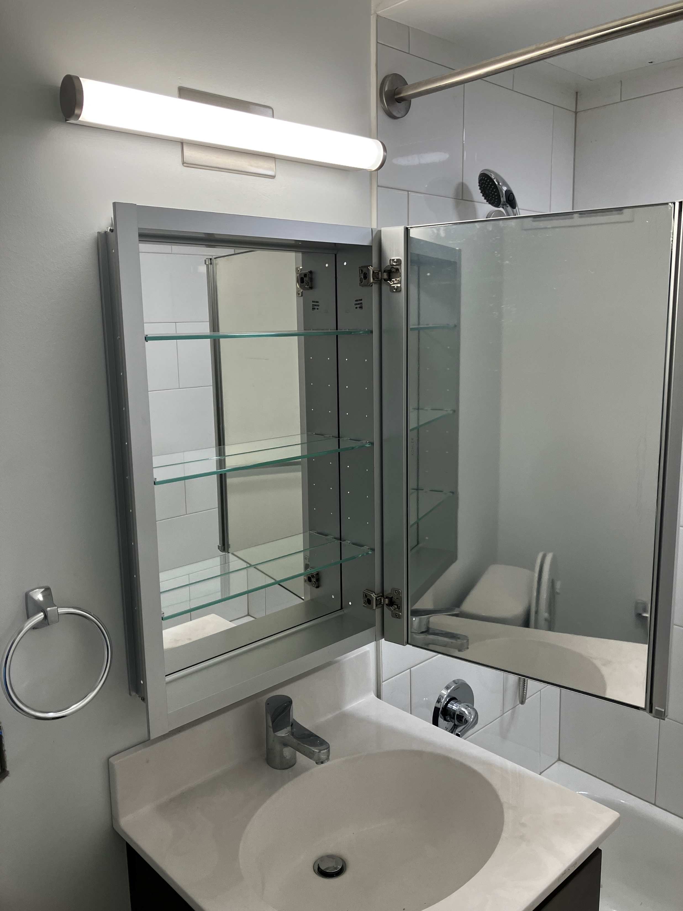
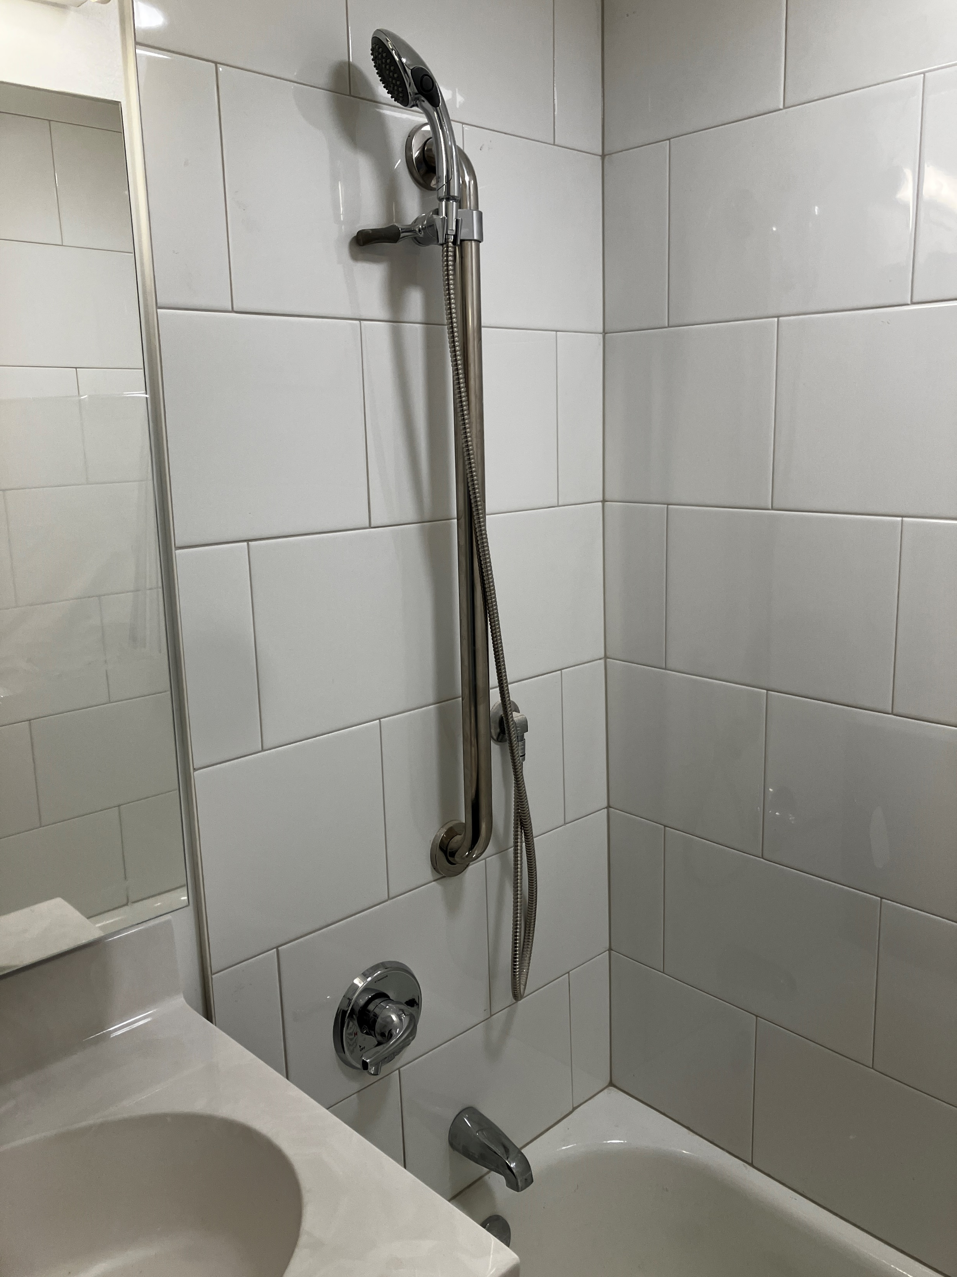
BATHROOM
Improved bathroom lighting
New showers with porcelain tile walls and detachable showerheads*
Bathroom mirror opens to a mirrored medicine cabinet
*Please note that a percentage of units will have preinstalled handicap accessible showers

Slide 7
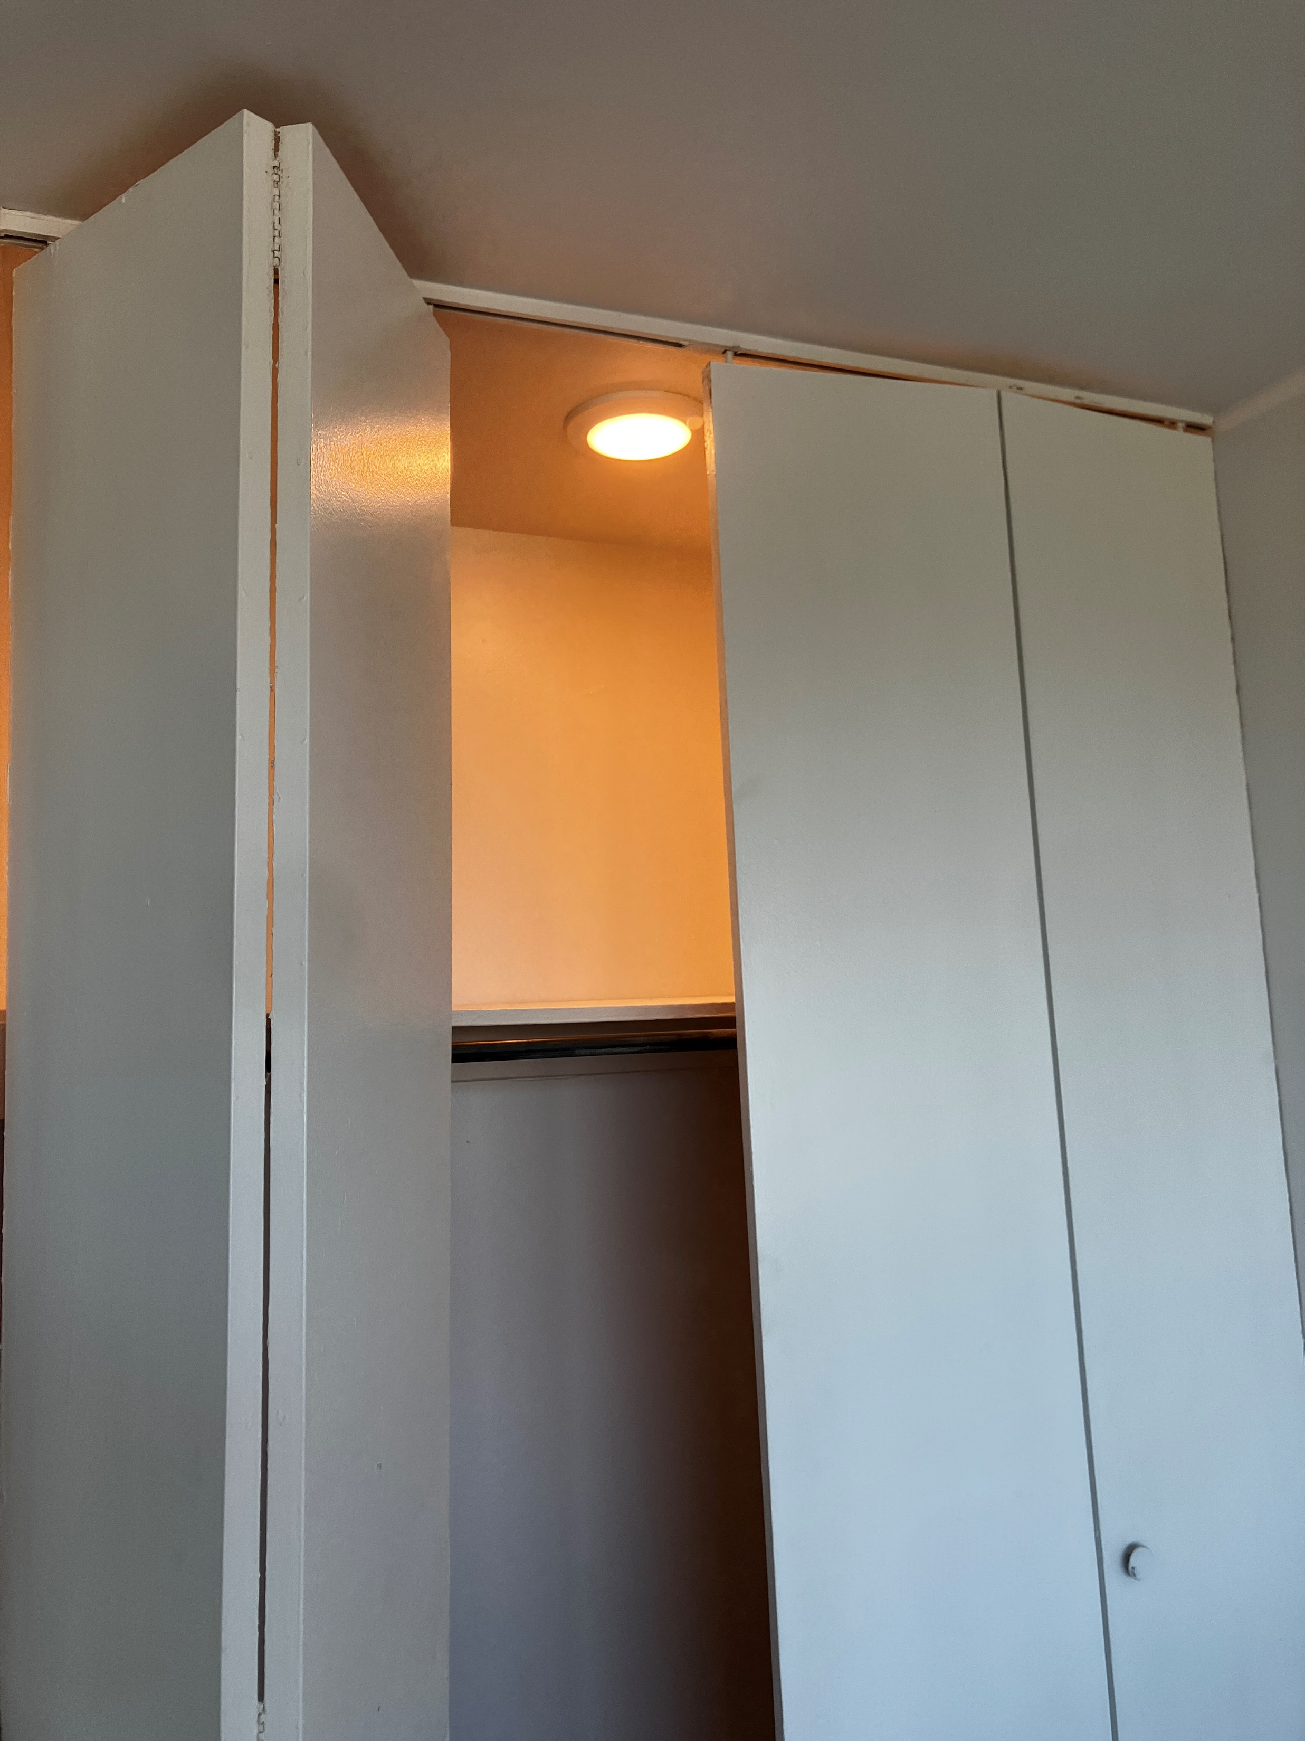
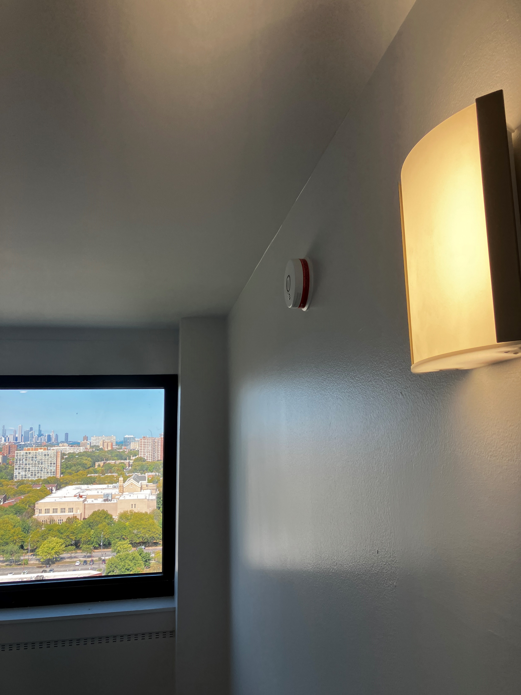
LIGHTING
Wall mounted sconce lighting are scattered throughout units to provide lighting variety
Motion sensor lights are installed in each closet for ease of access and improved energy efficiency

